Slide 1
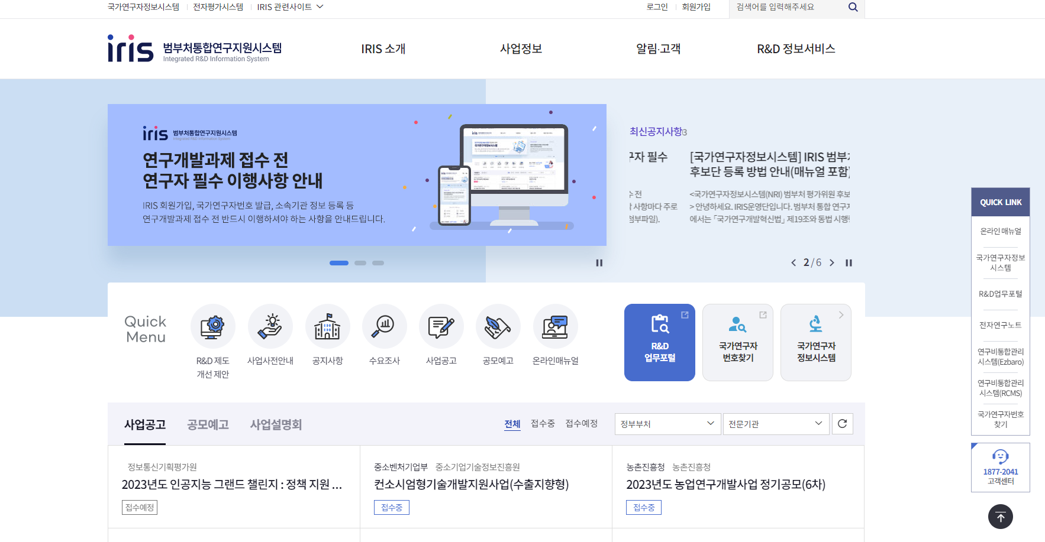
<How to Sign Up for IRIS>
(1) Join the membership

Slide 2
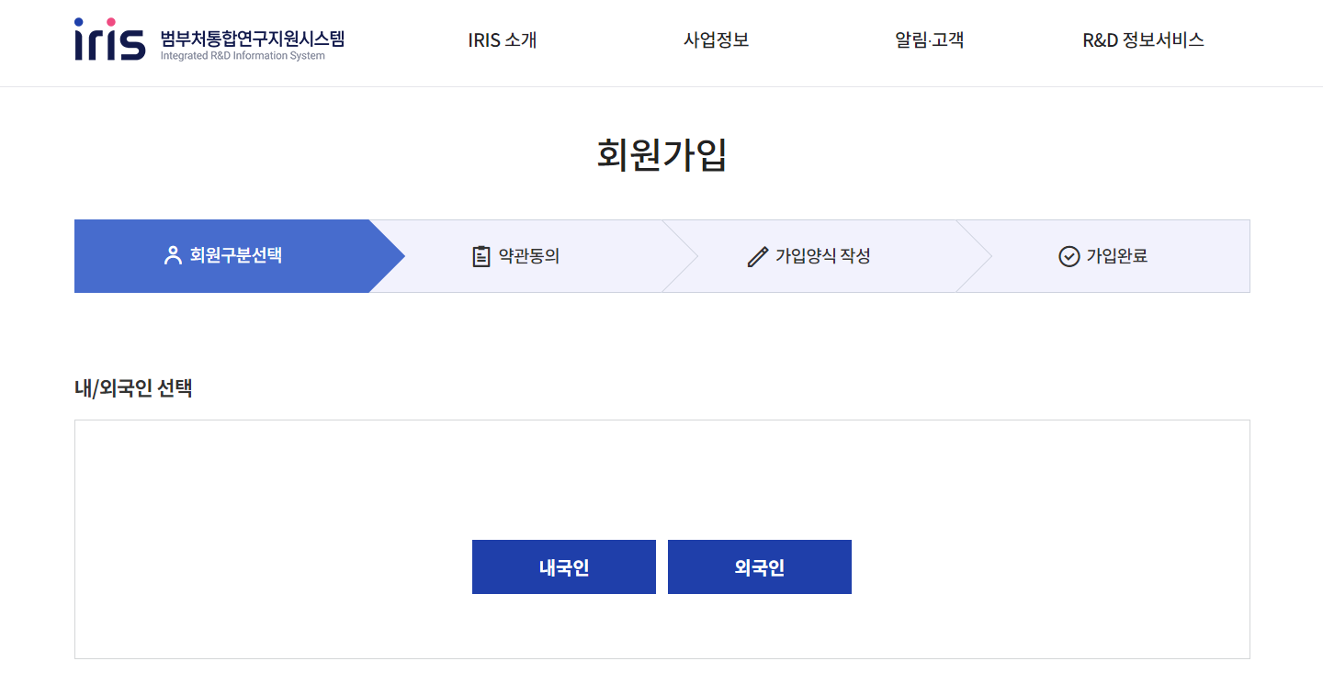
(2) Click ‘Foreigner’

Slide 3
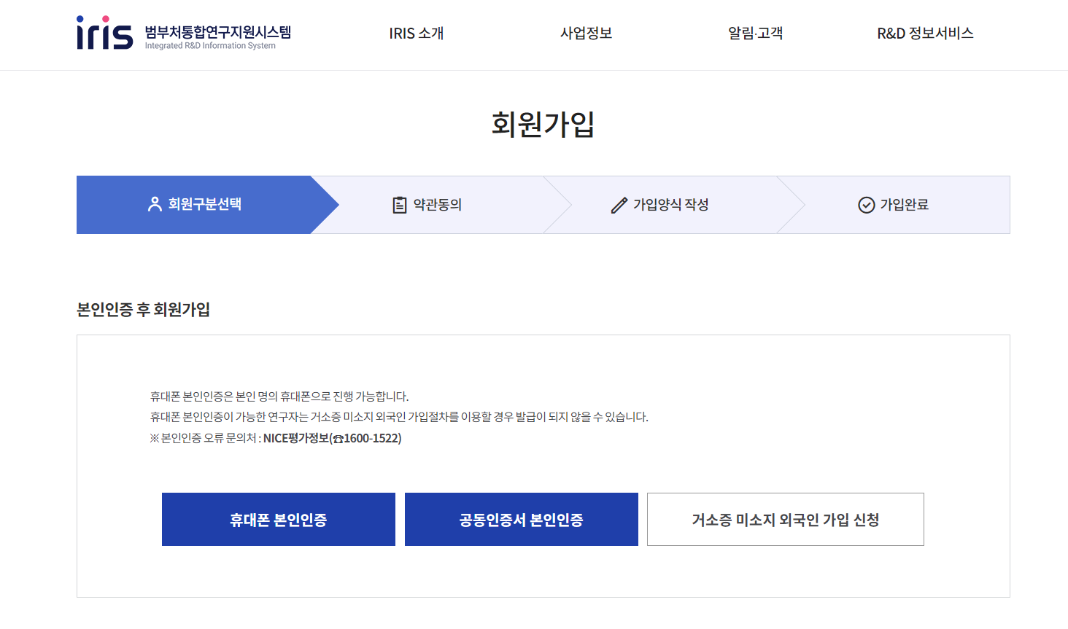
(3) Application for membership for foreigners who do not
Have a residence card

Slide 4
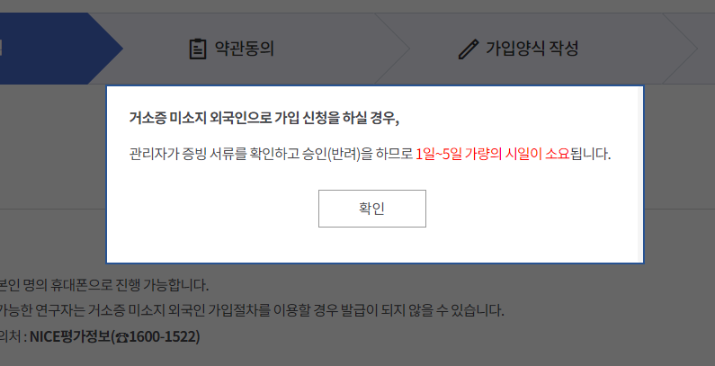
(4) Check

Slide 5
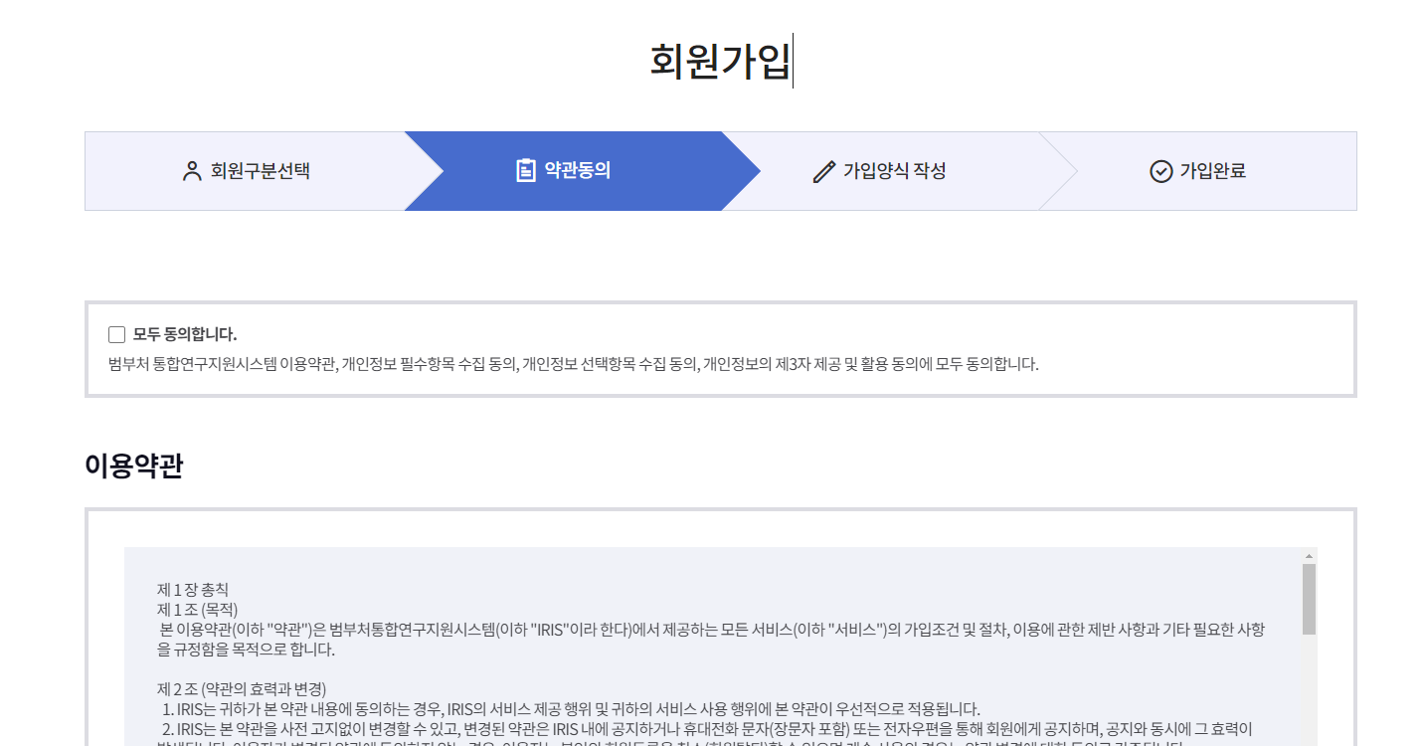

(5) Agree to terms and conditions
Yes, I agree No, I don’t agree

Slide 6
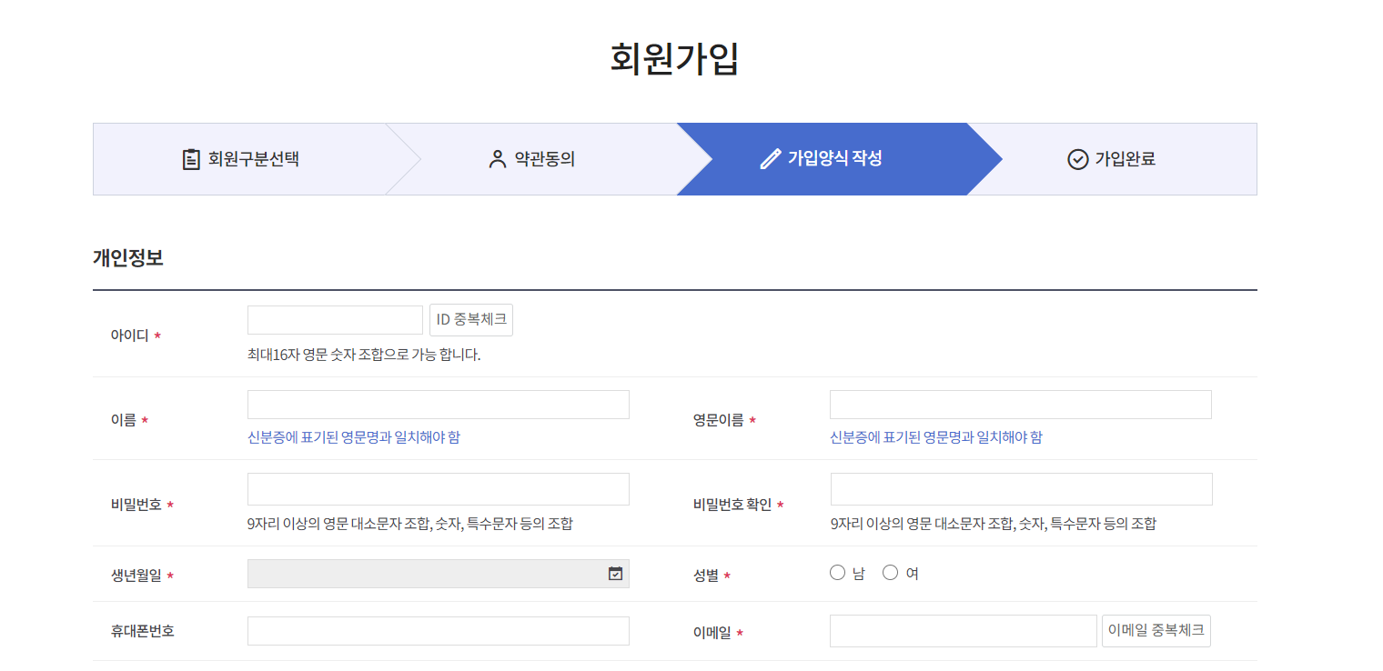
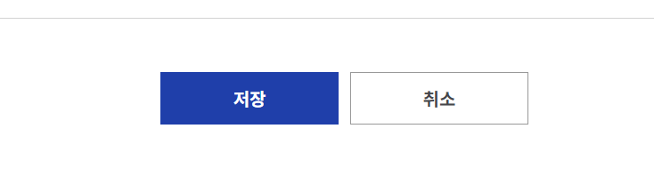
(7) Write down the information and save
* It takes 1~5 days for the approval
Save Cancel

Slide 7
<How to register a institution>
(1) Sign in

Slide 8
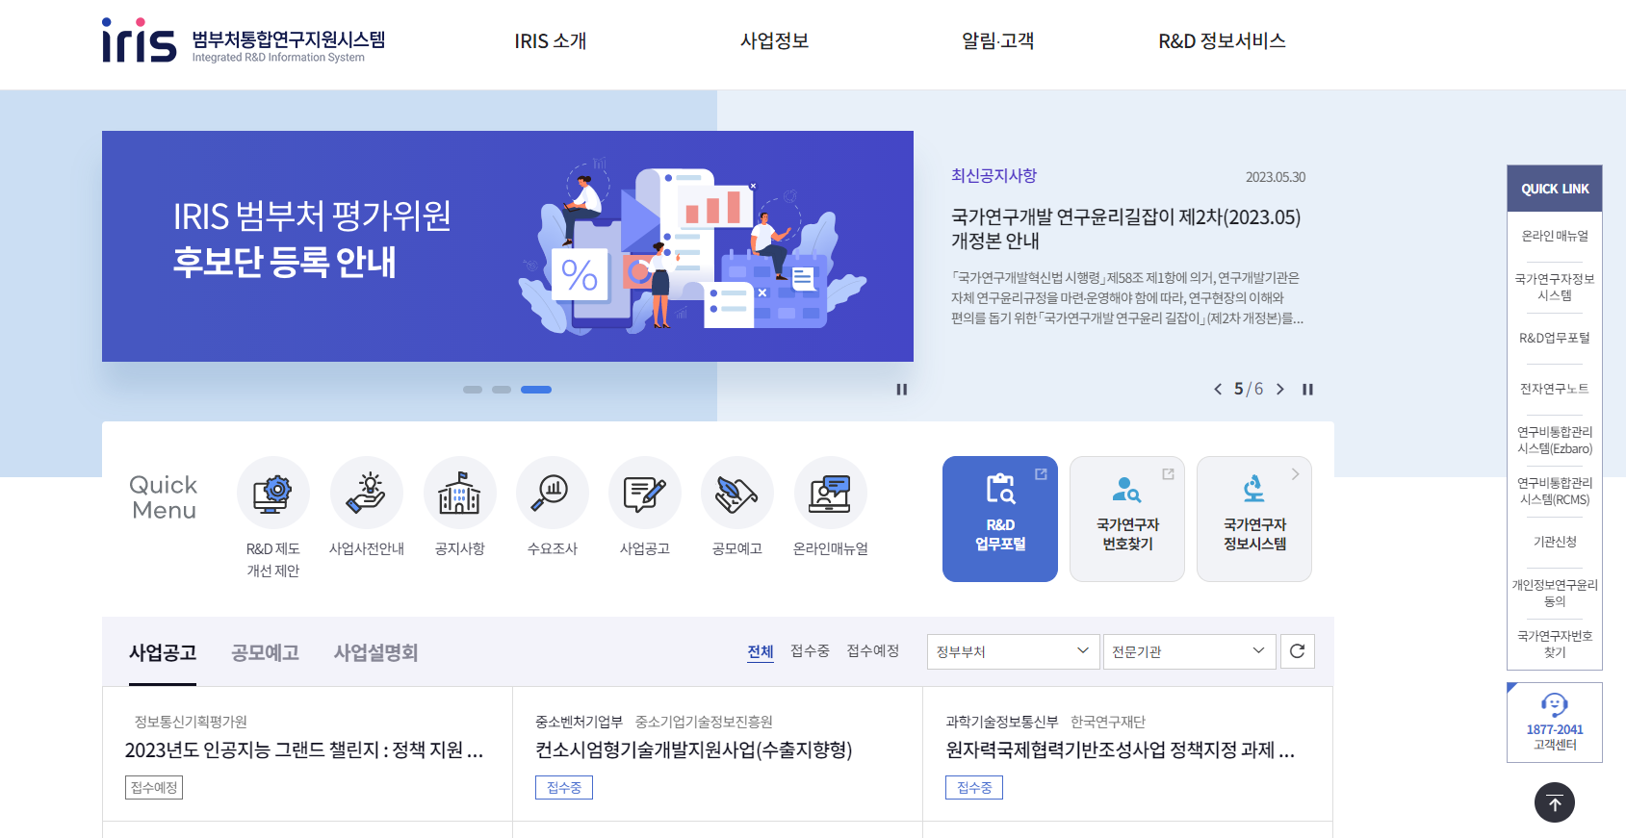
(2) Click ‘Institution Application(기관신청)’
of QUICK LINK on the right side

Slide 9
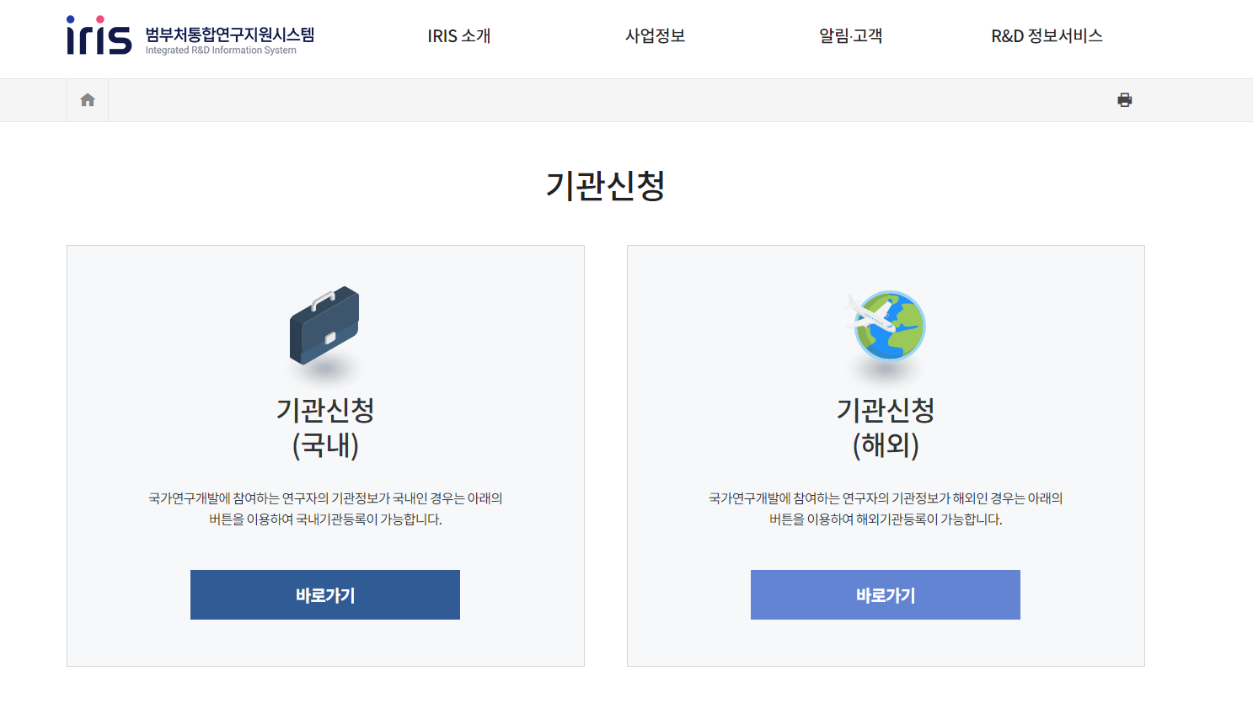
(3) Click ‘Shortcuts’ of institution application(overseas)

Slide 10
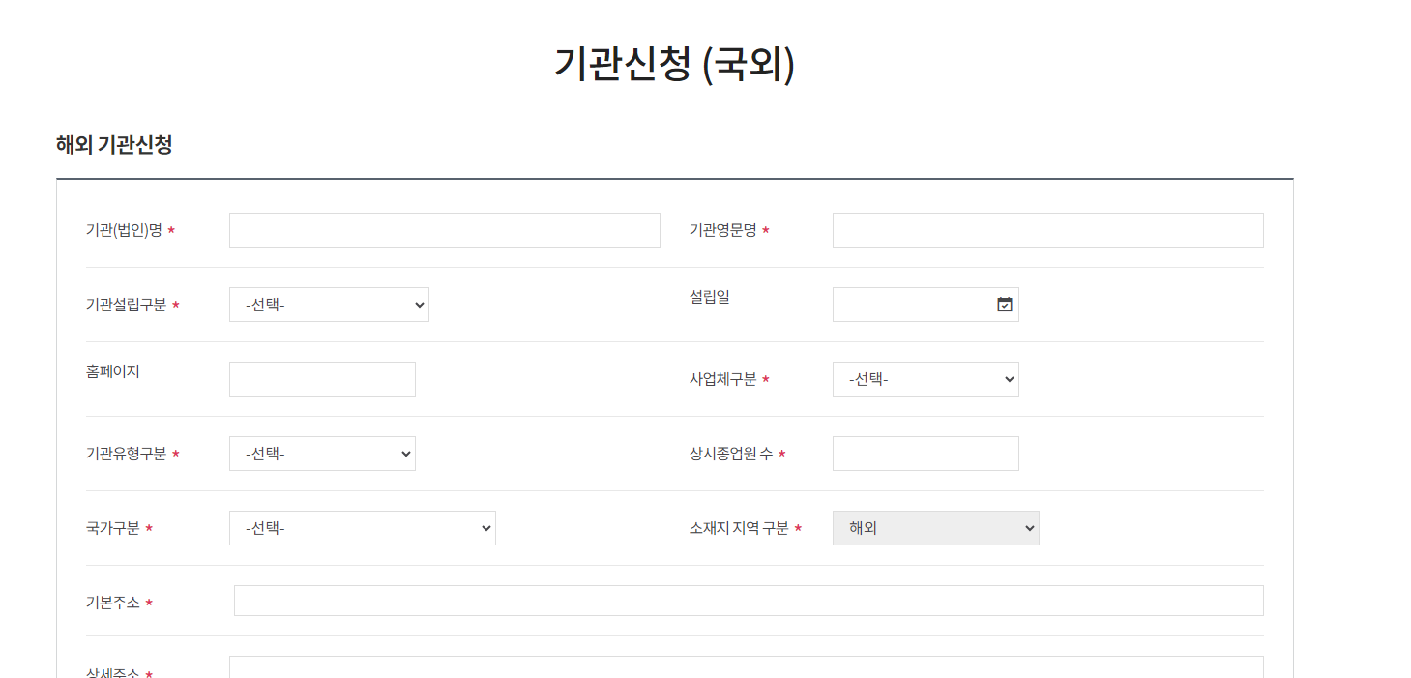

(4) Write down the information and apply
* It takes 1~5 days for the approval
application cancellation

Slide 11
<How to issue my NRI Researcher number >
(1) Sign in
(2) Click ‘국가연구자정보시스템(NRI)’

Slide 12
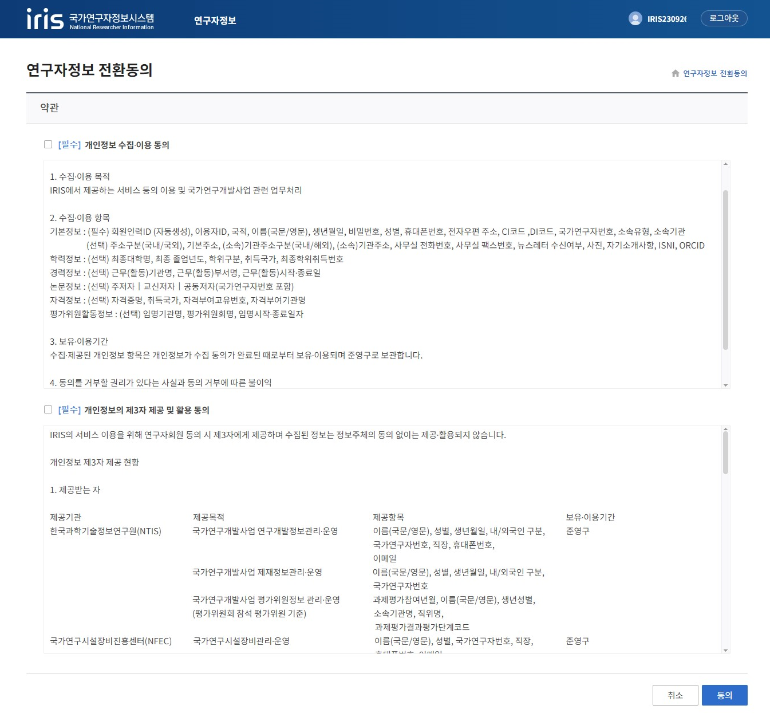
(3) Agree to terms and conditions to get a NRI Researcher number
(4) Check
(4) Check
(5) Agree

